Slide 1
Accident Severity Prediction Using Random Forest Algorithms

Slide 2
Problem Statement
The case study is predicting the severity of the accident. The Outcome of the case study is mainly targeted for Traffic departments, Travellers & Tourist, local residents and others those who use the roadway service for the day to day work.
Data Set
All collisions provided by SPD and recorded by Traffic Records. Description This includes all types of collisions. Collisions will display at the intersection or mid-block of a segment. Timeframe: 2004 to Present.
Rows 194673
Columns 38
Data Cleaning
Null Values Removed.
Null values replaced with accurate values
Encoding Data
Used One Hot encoding for numerical transformation.

Slide 3
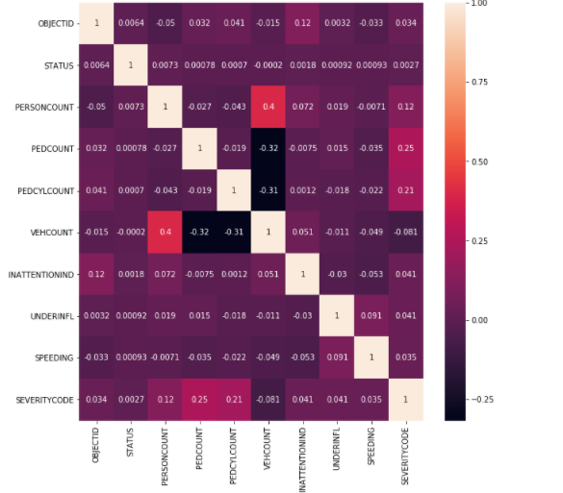
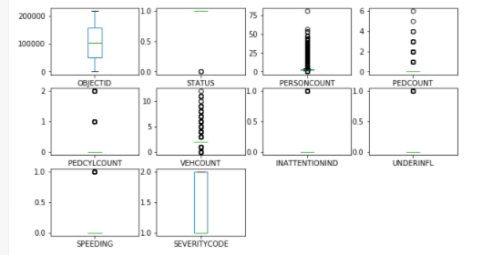
Data Correlation
Outlier's
Method – Pearson
Method – Box Plot

Slide 4
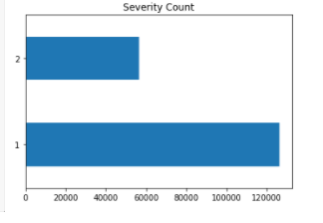
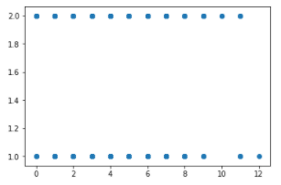
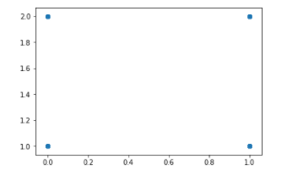
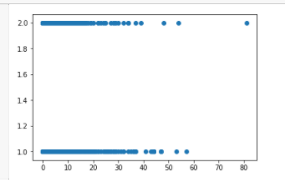
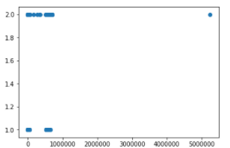
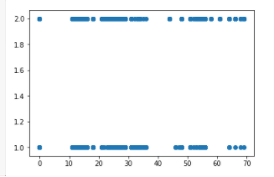
Data Correlation Using Scatter Plot

Slide 5
Balancing Data Set
Method – IMBLEARN
Before Balancing |  |  | After Balancing
1 | 84748 |  | 1 | 75960
2 | 37980 |  | 2 | 75960
Final Model Output
Method – Random Forest Classifier
Algorithm | Confusion Matrix |  | Precision | Recall | F1 Score | Accuracy
RandomForestClassifier | 21999 | 15261 | 73 | 71 | 71 | 71
 | 6110 | 31461

